Slide 1
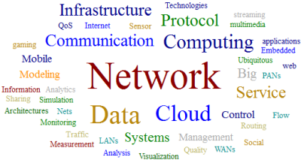
Data Communication and Networks
1

Slide 2
Course Objectives
1. Build an understanding of the fundamental concepts of computer networking, protocols, architectures, and applications
2. Gain expertise in design, implement and analyze performance perspective of ISO-OSI layered architecture
3. Deal with the major issues of the layers of the model.
4. Implement new ideas in Networking through semester long projects
5. Take advanced courses in Networking

Slide 3
Outcomes
1. Describe the layered structure of a typical networked architecture
2. Identify and analyze the different types of network topologies, switching, error and flow
control mechanisms
3. Design subnetting and enhance the performance of routing mechanisms.
4. Compare various congestion control mechanisms and identify suitable Transport layer
protocol for real time applications
5. Identify various Application layer protocols for specific applications

Slide 4
Books
TextBooks:
1. Computer Networks: A Systems Approach, Larry Peterson and Bruce Davie, 5th Ed, The Morgan Kaufmann Series, Elsevier, 2011.
2. Computer Networking: A Top-Down Approach Featuring the Internet, J.F. Kurose and K.W.Ross, 6th Ed., Pearson Education, 2012.
Reference Books
3. Data Communications and Networking, Behrouz A. Forouzan, McGraw Hill Education, 5th Ed., 2012.
4. TCP/IP Protocol Suite, Behrouz A. Forouzan,McGraw-Hill Education, 4 Ed., 2009.
5. Data and Computer Communications, William Stallings, Pearson Education,10th Ed,2013.

Slide 5
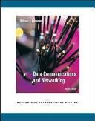
Course’s TextBook
Data Communication and Networking, Behrouz Forouzan, McGrawHill, 2006.
Available at the library, get your copy soon!

Slide 6
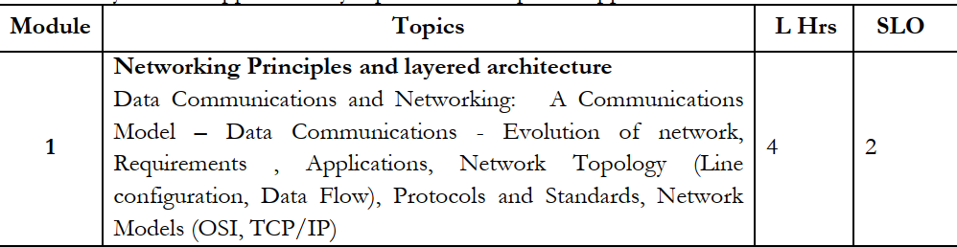

Slide 7
Chapter 1
Introduction
Data Communication
Networks
Protocols and Standards
Standard Organizations
WCB/McGraw-Hill
© The McGraw-Hill Companies, Inc., 1998

Slide 8
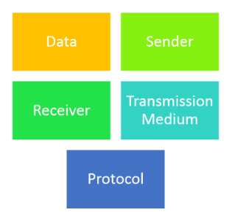
Data Communication

Slide 9
Definitions
Data: information presented in whatever form is agreed upon by the parties creating and using the data.
Data Communication: exchange of data between two devices via transmission medium (wire cable / link).
Data Communication System: Made up of a combination of hardware (physical equipment) and software (programs) to facilitate for effective communication of data.

Slide 10
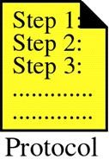
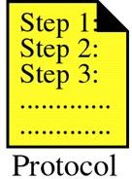
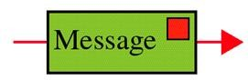


Components of a Data Communication System
Figure 1-1
Protocol: is a set of rules that governs data communications. It represents an agreement between the communicating devices. Without a protocol two devices may be connected but not communicating.

Slide 11
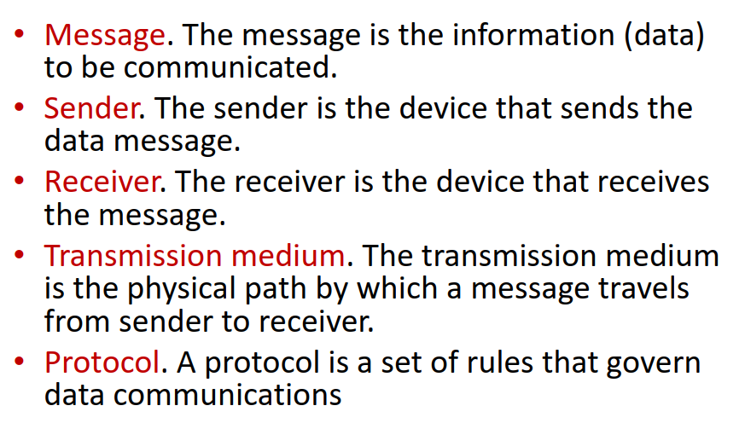

Slide 12
Characteristics of a Data Communication System
Delivery: System must deliver data to correct destination. Data must be received by only intended device or user.
Accuracy: The system must deliver data accurately
Timeliness: The system must deliver data in a timely manner. Data delivered later are useless.
Jitter: Variation in the packet arrival time. It is the uneven delay in the delivery of audio or video packets.

Slide 13
Data Flow
Path taken by data within a device, network, or organization, as it moves from its source to its destination (a data repository or a data user).
Categorized by direction of flow:
Simplex
Half-duplex
Full-duplex

Slide 14
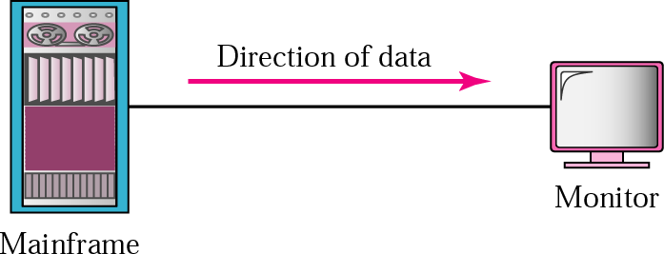
Simplex
Communication is unidirectional, one of the two devices on a link can transmit; the other can only receive (one-way street).
Ex: keyboard (input), monitors (output)

Slide 15
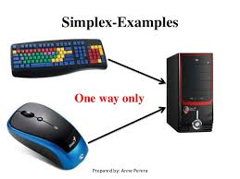
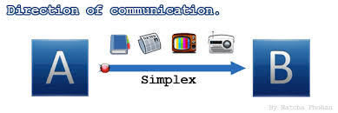

Slide 16
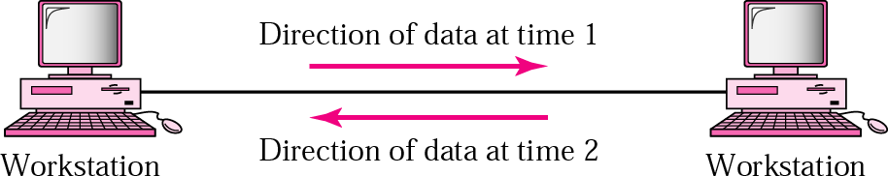
Half-duplex
Each station can both transmit and receive , but not at the same time. When one device is sending the other can receive and vice versa. (one-lane road with two direction).

Slide 17
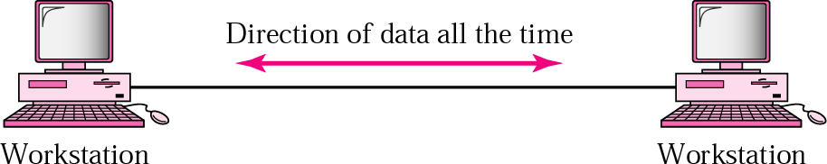
Full-duplex
Both stations can transmit and receive simultaneously. (two way street with traffic flowing in both directions at the same time).
Ex: telephone network.
Signals going in either direction share the capacity of the link in two ways:
Either the link must contain two physically separate transmission paths one for sending and other for receiving.
Capacity of the channel is divided between signals traveling in both direction

Slide 18
1.2 Networks

Slide 19
Definitions
A network is a set of devices (often referred to as nodes) connected by communication links.
A node can be a host (such as a computer, a laptop, a smart phone etc.) or a network device (such as a switch, a router, etc.).
A link is a communication pathway that transfer data from one device to another.

Slide 20
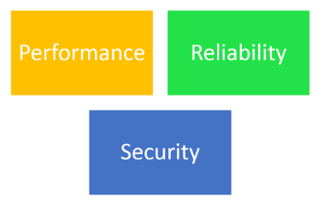
Network Criteria ( judged or Decided).
A network must be able to meet a certain number of criteria.
Performance
Reliability
Security

Slide 21
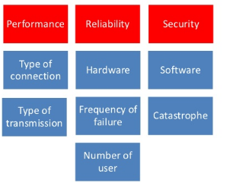

Slide 22
Performance
then the Transit Time is time required by the packet to reach from A to B via x-y-z,and the response time is time required by the packet to travel form A to B and then Back form B to A ( The response time)
So, Response Time = 2*Transit-time + Processing Time (at Node B)
Can be measured in many ways!
Transmit time: the amount of time required for a message to travel from one device to another.
Response time: the elapsed time between an inquiry and a response.
Often evaluated by two networking metrics: throughput and delay.

Slide 23
Factors Affecting Performance
Type of transmission media,
Capabilities of connected H.W and the efficiency of software.
Number of user

Slide 24
Network Criteria
A network must be able to meet a certain number of criteria.
Performance
Reliability
Security

Slide 25
Reliability
+Accuracy of delivery.
Measured by:
Frequency of failures
Time it takes to recover from a failure
The network’s robustness in a catastrophe(Sudden Damage- Attacks).

Slide 26
Network Criteria
A network must be able to meet a certain number of criteria.
Performance
Reliability
Security

Slide 27
Security
Many issues at the different layers!
Examples:
Protecting data from unauthorized access.
Protecting data from damage.
Implementing policies and procedures for recovery from breaches and data losses.

Slide 28
Network Configuration
There are a number of ways that computers can be connected together to form networks.
Physical attributes of a network include:
Type of connection
Physical topology

Slide 29
Type of Connection
For communication to occure, two devices must be connected in someway to the same link at the same time.
Two possible connections:
Point-to-point
Multipoint

Slide 30
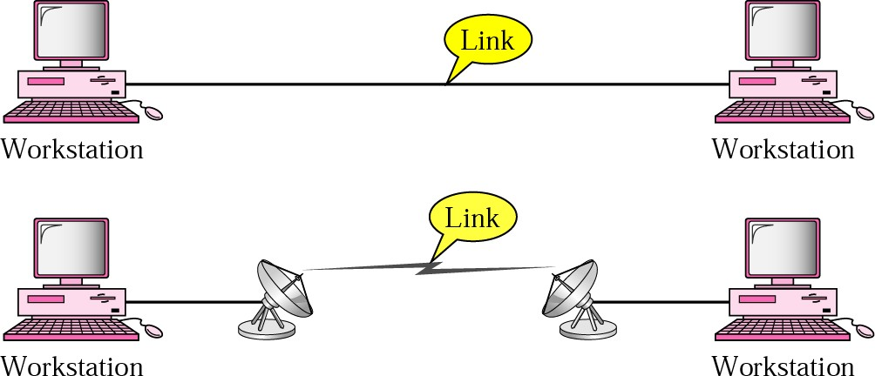
Physical Structures: Type of connection
1. Point –to-point
Dedicated link between two devices. Most of them uses an actual length of wire or cable to connect the two ends but other options ,such as microwave or satellite links are possible.
T.V Remote Control

Slide 31
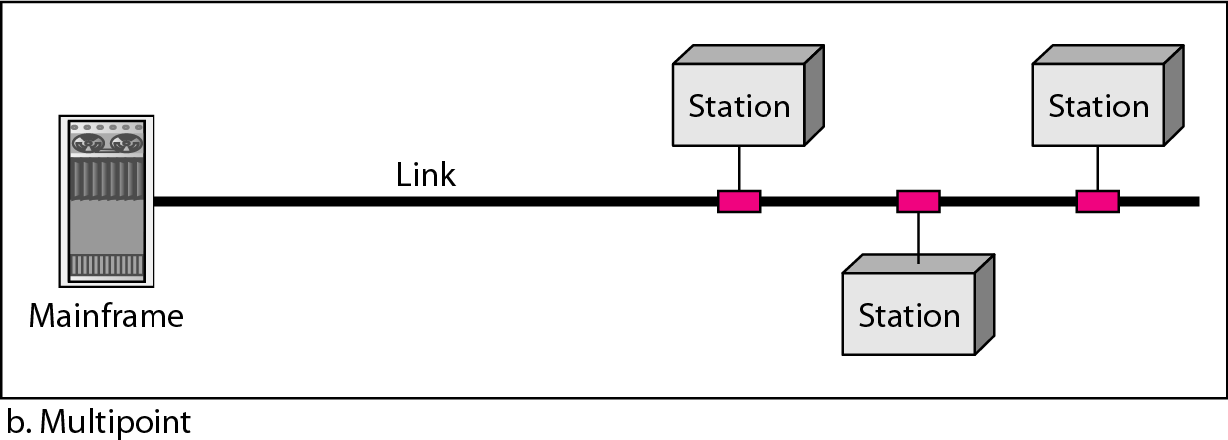
Physical Structures: Type of connection
2. Multipoint
Is one in which more than two specific devices share a single link
If several devices can use the link simultaneously, it is a spatially shared connection. If users must take turns, it is a timeshared connection.

Slide 32
Links
Each node needs one interface for each link.
point-to-point
multiple-access
(a)
(b)
Geographical coverage and scalability are limited.
49

Slide 33
Network Configuration
Physical attributes of a network include:
Type of connection
Physical topology

Slide 34
Physical Topology
Two or more links for a topology.
– The topology of a network refers to the geometric representation of the relationship of all the links and linking devices (nodes) to one another.
The term physical topology refers to the way in which a network is laid out physically.

Slide 35
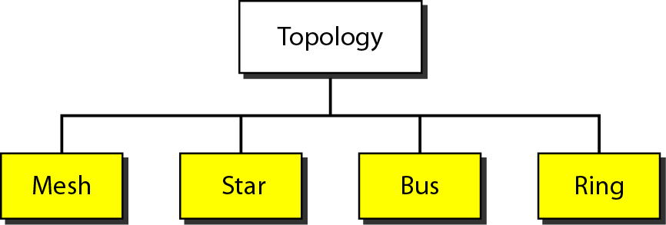
Physical Topology
The way in which a network is laid out physically.

Slide 36






Mesh Topology
Every device has a dedicated point-to- point link with every other device on the network
How many links do we need in a network with N nodes?
– Half duplex
- Full duplex
- traffic only between the two devices.

Slide 37
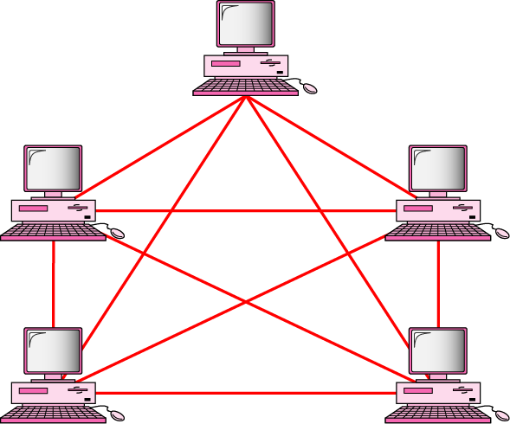
Fully connected mesh topology (for five devices)
Every device has a dedicated point-to-point link to every other devices
Fully connected mesh network has n(n-1)/2 physical connection to link n devices.
Every device on the network must have n-1 input/output (I/O) ports
Assume six devices are arranged in a mesh topology.
How many cables are needed? How many ports are needed for each device?

Slide 38
Advantages of a Mesh topology
Privacy or security (every message travels along a dedicated line, only the intended recipient sees it. Physical boundaries prevents other user from gaining access the message
eliminating the traffic problems The use of dedicated links guarantees that each connection can carry its own data load; that can occur when links must be shared by multiple devices.

Slide 39
Advantages of a Mesh topology
A mesh is robust. If one link becomes unusable, it does not incapacitate the entire system.
Fault identification and fault isolation easy. This enables the network manager to discover the precise location of fault and aids in finding its cause and solution.

Slide 40
Disadvantages of a Mesh topology
Related to the amount of cabling devices and the amount of I/O ports required:
Every device must be connected to every other device, installation and reconnection are difficult
The sheer bulk of the wiring can be greater than the available space can accommodate.
The H.W required to connect each link (I/O ports and cable) expensive.

Slide 41
Disadvantages of a Mesh topology
So a mesh topology is usually implemented in a limited fashion( as a backbone connecting the main computers of a hybrid network that can include several other topology

Slide 42
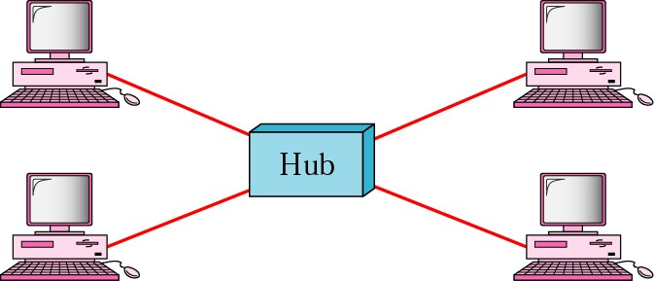
Star topology
Each device has a dedicated point-to-point link only to a central controller (hub)
Unlike a mesh , a star topology does not allow direct traffic between devices, if one device want to send data to another , it send it to the hub, which send it to other device

Slide 43
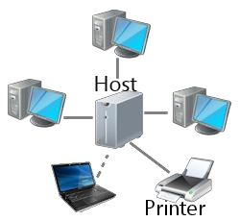
The star pattern connects everything to a host computer, a network switch, or a network hub, which handles the network tasks.
All communications between computers go through the host/switch/hub.

Slide 44
Advantages of a Star topology
Easy to install and reconfigure and less expensive
each device need only one link and I/O port to connect it to any other devices.)
Robustness:
if one link fails, only that link affected and other links remain active.
identification and fault isolation

Slide 45
Disadvantages of a Star topology
The dependency of the whole topology on one single point, the hub. If the hub goes down, the whole system is dead.

Slide 46
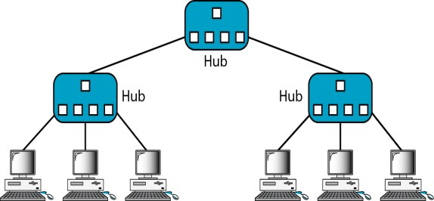
Tree topology : Is a variation of star
- Not every device plugs directly into the central hub. The majority of devices connect to secondary hub that in turn is connected to the central hub.

Slide 47
Tree topology : Is a variation of star
The advantages and disadvantages of tree topology are generally the same as those of star .
- The addition of secondary hubs bring more advantage: allows for more devices to be attached to a single central hub, therefore increase the distance a signal can travel between devices.

Slide 48
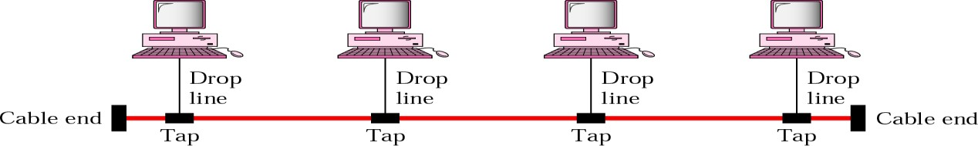
Bus topology
Multipoint connection. Acts as a backbone to link all the devices in a network.

Slide 49
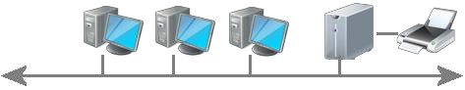
The bus pattern connects the computer to the same communications line. Communications goes both directions along the line. All the computers can communicate with each other without having to go through the server.

Slide 50
Bus topology
There is a limit on the number of taps a bus can support and on the distance between those taps
As a signal travels along the backbone, it becomes weaker

Slide 51
Advantages of a Bus topology
Ease of instulation, use less cabling than mesh or star.
-

Slide 52
Disadvantages of a Bus topology
A fault in bus cable (break) stops all transmissions even between devices on the same side of the problem. The damaged area reflects signals back the direction of origin, creating noise in both directions
Reconnection
It can difficult to add new devices (adding more require modification or replacement of the backbone).

Slide 53
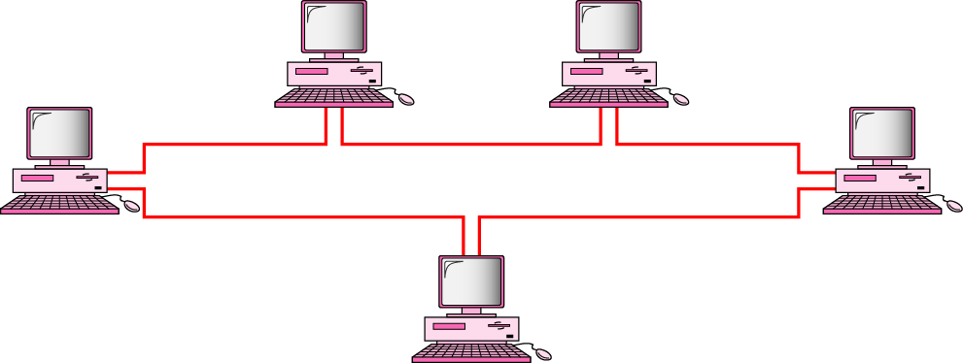
Ring Topology
Each device has a dedicated point-to-point connection only with the two devices on either side of it
A signal is passed along the ring in one direction from device until it reaches its destination.

Slide 54
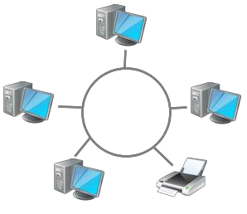
The ring pattern connects the computers and other devices one to the other in a circle.
There is no central host computer that holds all the data.
Communication flows in one direction around the ring.

Slide 55
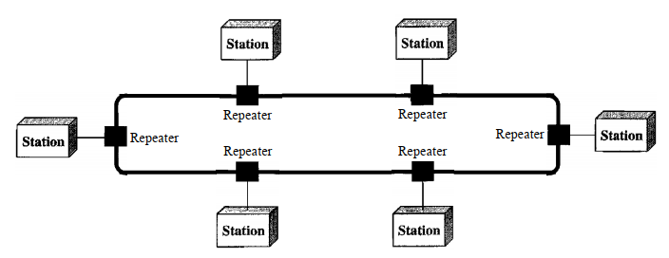
Ring Topology
Each device in the ring incorporate as repeater
Repeater :regenerates the signal
it receives a weakened signal, creates a copy, bit for bit, at the original strength

Slide 56
Ring Topology
Advantages:
Easy to install and reconfigure.
Each device is linked only to its immediate neighbors. To add or delete a device requires hanging only 2 connections
Fault isolation is simplified :
A signal is circulating at all times (token) if one device does not receive a signal within specified period, it can issue an alarm. The alarm alerts the network operator to the problem and its location
Disadvantages
Unidirectional traffic.
A break in the ring (such as disabled station) can disable the entire network. This can be solved by use dual ring

Slide 57
Advantages of a Ring Topology
Easy to install and reconfigure.
Each device is linked only to its immediate neighbors. To add or delete a device requires hanging only 2 connections
Fault isolation is simplified :
A signal is circulating at all times (token) if one device does not receive a signal within specified period, it can issue an alarm. The alarm alerts the network operator to the problem and its location

Slide 58
Disadvantages of a Ring Topology
Unidirectional traffic.
A break in the ring (such as disabled station) can disable the entire network. This can be solved by use dual ring

Slide 59
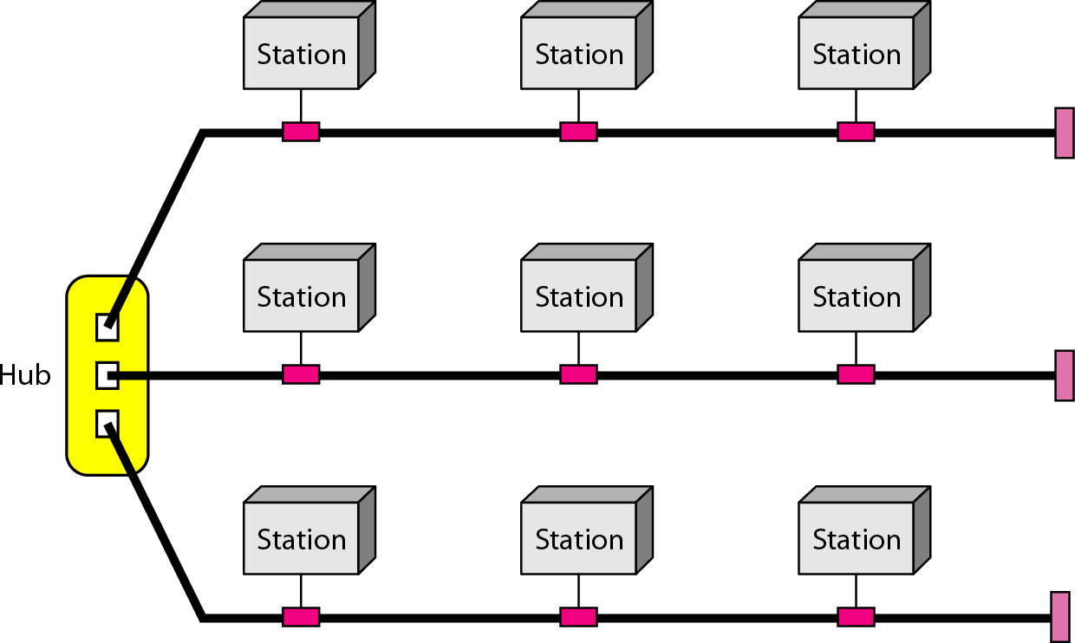
A hybrid topology: a star backbone with three bus networks

Slide 60
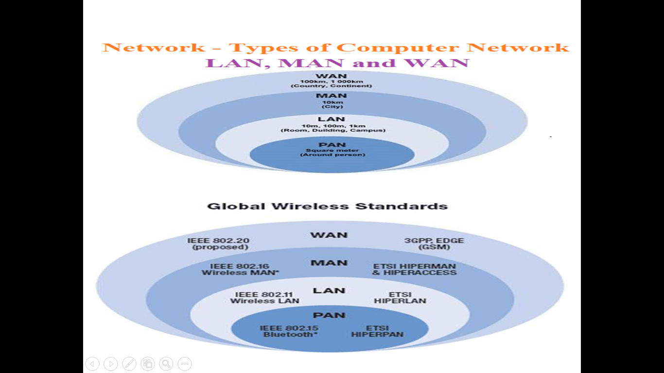
Network Category

Slide 61
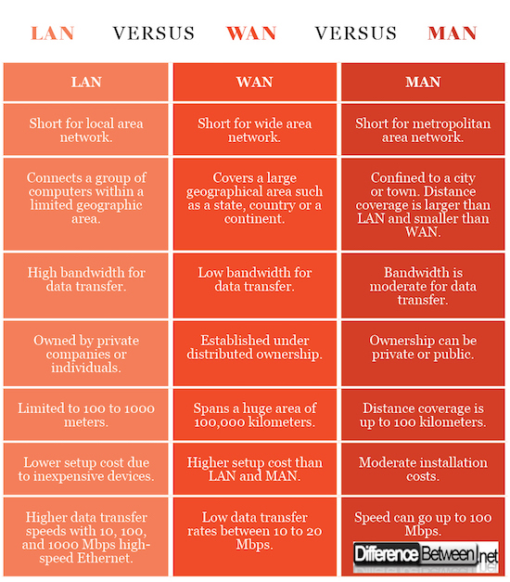

Slide 62
Evolution of Network /Internet

Slide 63
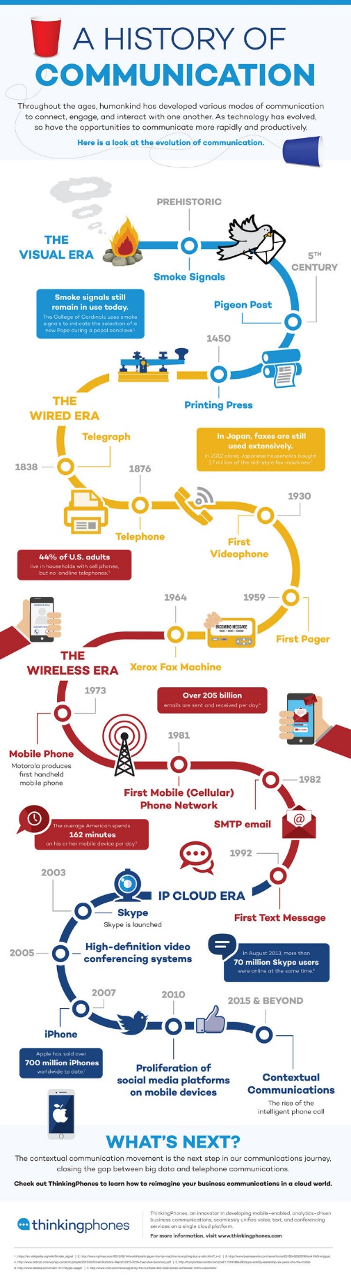
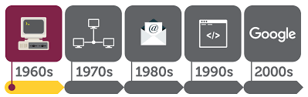
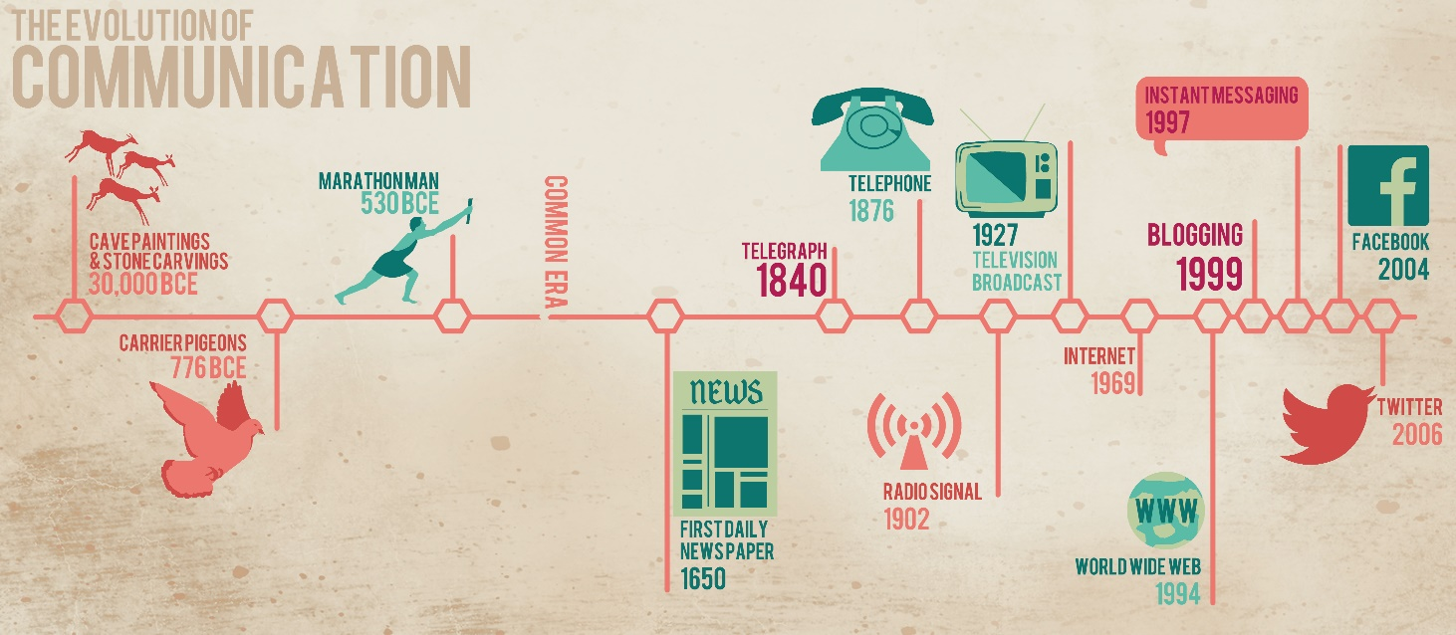
Technology Revolution
18th Century Mechanical systems
19th Century Steam Engine
20th Century Information
gathering
distribution
processing
creating
63

Slide 64
Interconnection of Networks:
Internetwork
An internet (small i) is two or more networks that can communicate with each other.

Slide 65









Internetworking
To interconnect two or more networks, one needs a gateway or router.
Host-to-host connectivity is only possible if there’s a uniform addressing scheme and a routing
mechanism.
Messages can be sent to a single destination (unicast), to multiple destinations (multicast), or to all possible destinations (broadcast).
1/18/2006
CSCI 363 Computer Networks
89

Slide 66
1.3 The Internet

Slide 67
Internet
a collaboration of more than 100 of 1000 interconnected network.
Brief History ( self-reading)
In mid of 1960:
The Advanced Research Projects Agency (ARPA) in the department of defense was interested in finding a way to connect computers so that the researchers they funded could share their findings, to reduce costs and eliminating duplication of effort.

Slide 68
Brief History
1n1967
ARPA presented its ideas for ARPANET, small network of connected computers (mainframe).
1n 1969,
ARPANET was reality. Four nodes at the UNV. Of California,(at los angles and Santa Barba), univ. of utah and SRI (Stand ford Research Institute connected via IMPs computers to form a network. Software called Network Control Protocol (NCP) provided communication between the hosts.

Slide 69
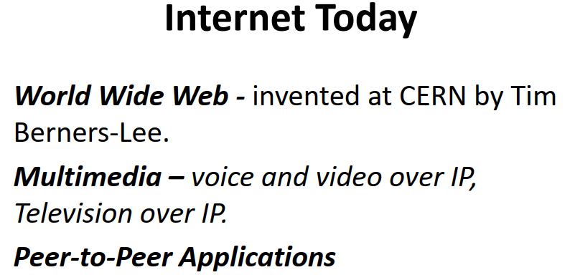
Brief History
In 1972,- Birth of Internet
Protocol to achieve end -to-end delivery of packets, Transmission Control Protocol (TCP).
Authorities made decision to split TCP into two protocols:
IP: Internetworking protocol to handle datagram routing and
TCP: responsible for higher-level-functions such as error detection, segmentation and reassembly.
Internet today
Made up of many wide and local area networks joined by connecting devices and switching stations. Today most end users use the services of internet service providers (ISPs).

Slide 70
internet service providers (ISPs)
Hierarchical organization of the Internet includes:
International Internet Service Providers
National Internet Service Providers
Regional Internet Service Providers
Local Internet Service Providers

Slide 71
1.4 Protocols and Standards

Slide 72
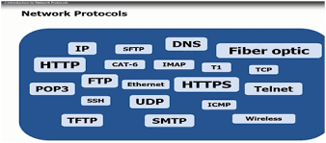
Protocols and Standards
Protocols
Standards
Standards Organization

Slide 73
Protocols
Set of rules that governs data communications.
Protocol defines :
– What is communicated?
– How it communicated?
– When it is communicated?

Slide 74
What’s a protocol?
human protocols: network protocols:
“what’s the time?”
“I have a question”
introductions
machines rather than humans
all communication activity in Internet governed by protocols
… specific msgs sent
… specific actions taken when msgs received, or other events
protocols define format, order of msgs sent and received among network
entities, and actions taken on msg transmission and/or receipt of a msg.

Slide 75
Protocols
Key elements of a protocol: Syntax, semantics and timing
Syntax: Structure or format of the data, meaning the order in which they are presented. Example: A simple protocol might expect the first byte of data to be the address of the sender, the second byte to be the address of the receiver and the reset of the stream to be the message itself.

Slide 76
Protocols
Semantics: Refers to the meaning of each section of bits.
Example: does an address identify the route to be taken or the final destination of the message.

Slide 77
Protocols
Timing: When data to should be sent?
How fast they can be sent? Example: If a sender produces data at 100Mpbs but the receiver can process data at only 1Mpbs, transmission will overload the receiver and data will be largely lost.

Slide 78
Standards
Provide guidelines to manufactures, vendors, government agencies and other service provides to ensure the kind of interconnectivity necessary in today's marketplace and international communication.

Slide 79
Standards
Two categories:
1.De fact: standers
Have been through
adopted as
use.
widespread
Established by manufacturers that define the functionality of a new product or technology
2.De jure: officially recognized body.

Slide 80
Standers Organization
International Organization for Standardization (ISO)
Non-governmental, international organization that develops standards to ensure the quality, safety, and efficiency of products, services, and systems
•Developed – OSI Model

Slide 81
Standers Organization
International Telecommunication Union Telecommunication standard sector ( ITU-T)
devoted to the research of standards for telecommunication in general and for phone and data system in particular
Data transmission over telephone line Modems standards :V- series( V32, V34,V90)
X-series: data transmission over public digital network (e- mail)

Slide 82
Standers Organization
3.American National Standards Institute (ANSI)
– completely private, nonprofit corporation
voluntary consensus standards for products, services, processes, systems, and personnel in the United States.

Slide 83
Standers Organization
Institute of Electrical and Electronics Engineers (IEEE)
International in scoop
In the fields of electrical engineering, electronics and all related branches of engineering
International standards for computing and communications LAN (project 802): IEEE Ethernet 802.3
5. Electronic Industries Association (EIA)
Direct component marking, data modeling, color coding and packaging materials

Slide 84
OSI Model
by ISO

Slide 85
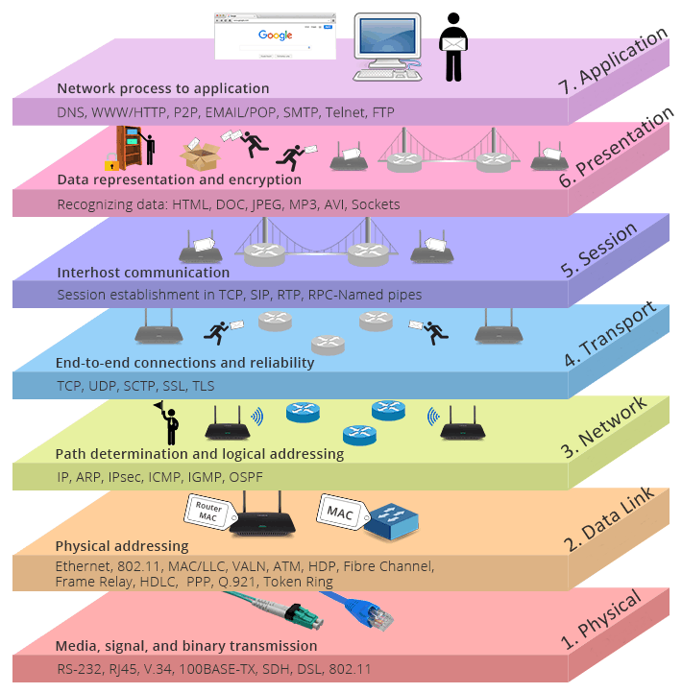
OSI/TCP Protocol Stack

Slide 86
Layer Architecture
OSI Model
Layer architecture simplifies the network design.
It is easy to debug network applications in a layered architecture network.
The network management is easier due to the layered architecture.
Network layers follow a set of rules, called protocol.
The protocol defines the format of the data being exchanged, and the control and timing for the handshake between layers.

Slide 87
Open Systems Interconnection (OSI) Model
OSI Model
International standard organization (ISO) established a committee in 1977 to develop an architecture for computer communication.
Open Systems Interconnection (OSI) reference model is the result of this effort.
In 1984, the Open Systems Interconnection (OSI) reference model was approved as an international standard for communications architecture.
Term “open” denotes the ability to connect any two systems which conform to the reference model and associated standards.

Slide 88
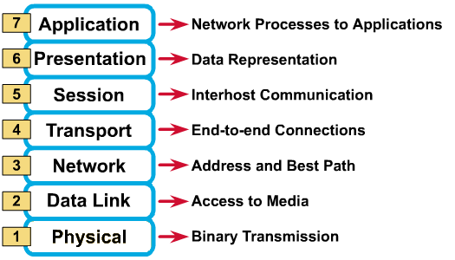
OSI Reference Model: 7 Layers

Slide 89

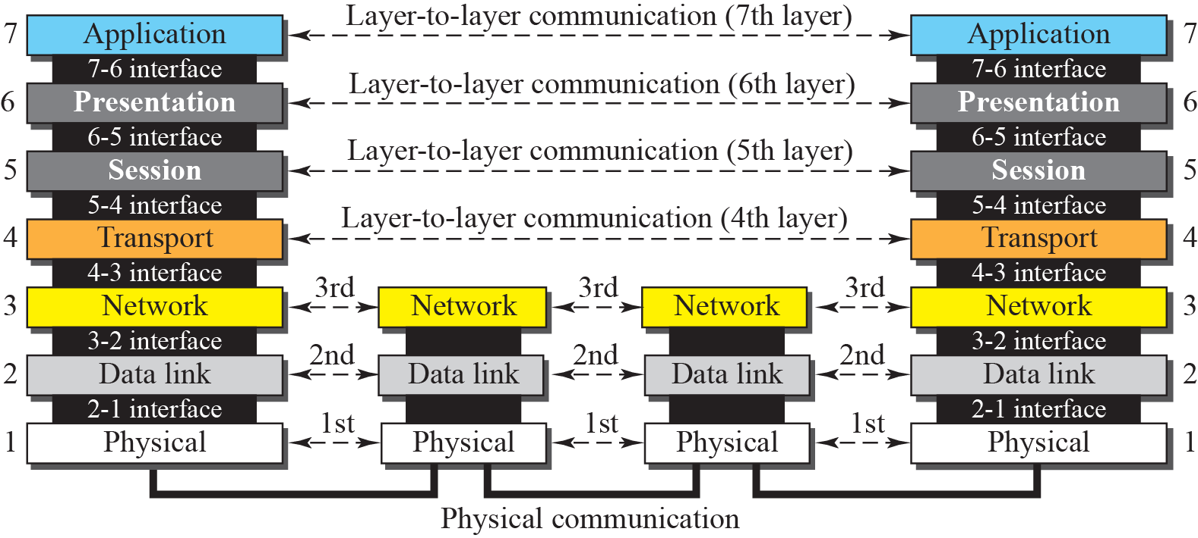

Slide 90
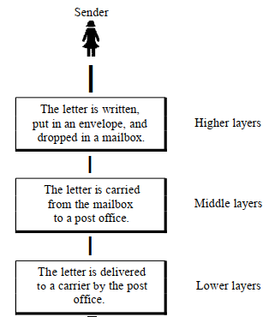
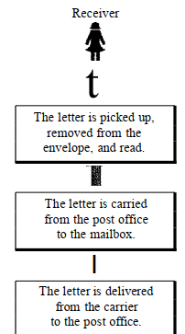


Slide 91
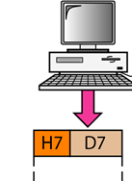
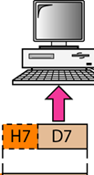
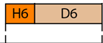
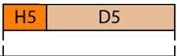
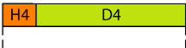
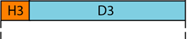
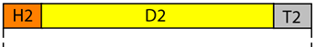
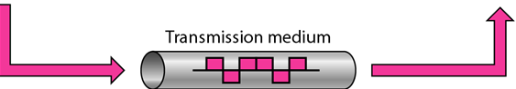
Exchange using the OSI Model
Encapsulation is the process of enclosing one type of packet using another type of packet
Decapsulation is the process of opening up encapsulated data

Slide 92

It enables the user, to access the network. It provides user interfaces and support for services such as electronic mail, remote file access and transfer,etc
Protocols, HTTP. SNMP, SMTP,FTP,Telnet, WWW, DNS..etc

Slide 93
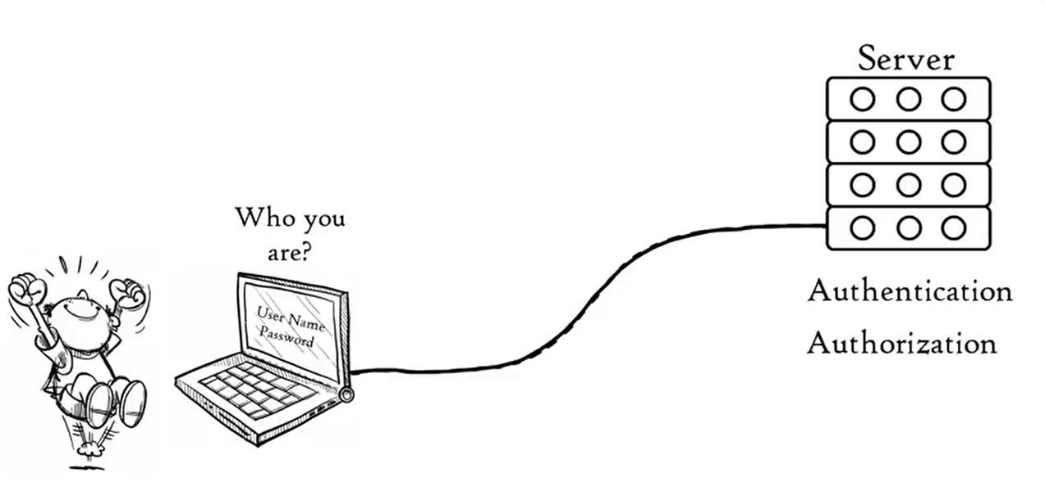
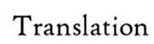






Presentation Layer
Session Layer
Session Layer controls the dialogues between computers. It helps you to establish starting and terminating the connections between the local and remote application
It establishes, maintains, and ends a session.
Session layer enables two systems to enter into a dialog

Slide 94





Transport Layer
Port Number used to identify the process

Slide 95


Flow Control
flow control is the process of managing the rate of data transmission between two nodes to prevent a fast sender from overwhelming a slow receiver.

Slide 96




Slide 97

Importance of Transport Layer
Ensures that the data units are delivered error free.
Ensures that data units are delivered in sequence.
Ensures that there is no loss or duplication of data units.
Provides connectionless or connection oriented service.
Reliable process-to-process delivery of a message

Slide 98


Network Layer
responsible for the source-to-destination delivery of a packet, possibly across multiple networks (links).
Other responsibilities Logical Addressing
Routing.

Slide 99
Importance of Network layer
Implements routing of frames (packets) through the network.
Defines the most optimum path the packet should take from the source to the destination
Defines logical addressing so that any endpoint can be identified.
Facilitates interconnection between heterogeneous networks (Internetworking).

Slide 100
Data Link Layer
The data link layer is responsible for moving frames from one hop (node) to the next
Framing. The data link layer divides the stream of bits received from the network layer into manageable data units called frames
. Data link layer attempts to provide reliable communication over the physical layer interface.
Breaks the outgoing data into frames and reassemble the received frames.
Create and detect frame boundaries.
Handle errors by implementing an acknowledgement and retransmission scheme.
Implement flow control.
The data link layer is subdivided into two types of sublayers:
Media Access Control (MAC) layer- It is responsible for controlling how device in a network gain access to medium and permits to transmit data.
Logical link control layer- This layer is responsible for identity and encapsulating network-layer protocols and allows you to find the error.
Allows you to add header to the frame to define the physical address of the source and the destination machine

Slide 101


Slide 102

Physical Layer
Provides physical interface for transmission of information.
Defines rules by which bits are passed from one system to another on a physical communication medium.
Covers all - mechanical, electrical, functional and procedural - aspects for physical communication.
Data rate. The transmission rate-the number of bits sent each second-is also defined by the physical layer
Line configuration
Physical topology.
Transmission mode.

Slide 103



Slide 104

Summary

Slide 105

TCP/IP Protocol Suite

Slide 106
Introduction
The TCP/IP protocol suite, also referred to as the Internet protocol suite
It is named after the two most important protocols in the suite: the Transmission Control Protocol (TCP) and the Internet Protocol (IP)
The TCP/IP protocol suite was developed before the OSI reference model. As such, it does not directly map to the 7-layer OSI reference model. The TCP/IP protocol stack has only 5 layers that can be loosely mapped to the OSI protocol stack,

Slide 107
Application Layer
Application layer in TCP/IP is equivalent to the combined session, presentation, and application layers in the OSI model.
The TCP/IP specifications described a lot of applications that were at the top of the protocol stack. Some of them were TELNET, FTP, SMTP, DNS etc.
TELNET is a two-way communication protocol which allows connecting to a remote machine and run applications on it.
FTP(File Transfer Protocol) is a protocol, that allows File transfer amongst computer users connected over a network. It is reliable, simple and efficient.
SMTP(Simple Mail Transport Protocol) is a protocol, which is used to transport electronic mail between a source and destination, directed via a route.
DNS(Domain Name Server) resolves an IP address into a textual address for Hosts connected over a network.

Slide 108
Transport Layer
It decides if data transmission should be on parallel path or single path.
Functions such as multiplexing, segmenting or splitting on the data is done by transport layer.
Transport layer breaks the message (data) into small units so that they are handled more efficiently by the network layer.
Transport layer also arrange the packets to be sent, in sequence.
Transport layer was represented in TCP/IP by two protocols:
Transmission Control Protocol and User Datagram Protocol.
Stream Control Transmission Protocol newer applications such as voice over the Internet. It is a transport layer protocol that combines the best features of UDP and TCP.

Slide 109



Slide 110
Network Layer
Selection of a packet switching network which is based on a connectionless internetwork layer is called a internet layer.(at the network layer, is a packet-switched network –Connectionless-Unreliable)
It is the layer which holds the whole architecture together.
It helps the packet to travel independently to the destination.
Order in which packets are received is different from the way they are sent.
The various functions performed by the Internet Layer are:
Delivering IP packets
Performing routing
Avoiding congestion
TCP/IP supports the Internetworking Protocol(IP).
IP, in turn, uses four supporting protocols: ARP, RARP, ICMP, and IGMP

Slide 111

Internetworking Protocol (IP) The Internetworking Protocol (IP) is the transmission mechanism used by the TCP/IP protocols
Unreliable, connectionless protocol-a best-effort delivery service. The term best effort means that IP provides no error checking or tracking. IP transports data in packets called datagrams
1 ARP: Address Resolution Protocol (ARP) is a procedure for mapping a dynamic Internet Protocol address (IP address) to a permanent physical machine address in a local area network (LAN)
2 RARP: Reverse Address Resolution Protocol (RARP) allows a host to discover its Internet address when it knows only its physical address. It is used when a computer is connected to a network for the first time or when a diskless computer is booted 3 Internet Control Message Protocol The Internet Control Message Protocol (ICMP) is a mechanism used by hosts and gateways to send notification of datagram problems back to the sender 4 The Internet Group Message Protocol (IGMP)

Slide 112

Data Link Layer and Physical Layer
Coverts the data units into frames, Error detection and Corrections done
Supporting protocols, IEEE 802.3, IEEE 802.4, IEEE 802.5, 802.11,,etc
Physical layer converts the data into bits,

Slide 113



Slide 114
Merits of TCP/IP model
It operated independently.
It is scalable.
Client/server architecture.
Supports a number of routing protocols.
Can be used to establish a connection between two computers.
Demerits of TCP/IP
In this, the transport layer does not guarantee delivery of packets.
The model cannot be used in any other application.
Replacing protocol is not easy.

Slide 115


